Slide 1

House Price Market Analysis
(Pakistan)
By: Omama Qadeer & Mohib Ali Khan

Slide 2


What This Project Is About
In-depth Study
We conducted a comprehensive analysis of house prices across key urban centers in Pakistan.
Key Cities
Our focus was on major metropolitan areas: Islamabad, Lahore, and Karachi, representing diverse real estate markets.
Understanding Value Drivers
The primary goal was to identify and understand the factors that influence property values, leading to price appreciation or depreciation.
Predictive Modeling
We also developed advanced Machine Learning models to accurately predict future house prices, providing valuable insights for various stakeholders.

Slide 3

Why House Prices Matter
For Buyers
Understanding market dynamics ensures buyers can secure properties at a fair and equitable price, maximizing their investment.
1
For Investors
Knowledge of pricing trends is crucial for strategic investment decisions, helping to identify high-growth areas and potential returns.
2
For Real Estate Companies
Accurate predictive models empower real estate firms to set competitive and realistic prices, optimizing sales and market positioning.
3

Slide 4

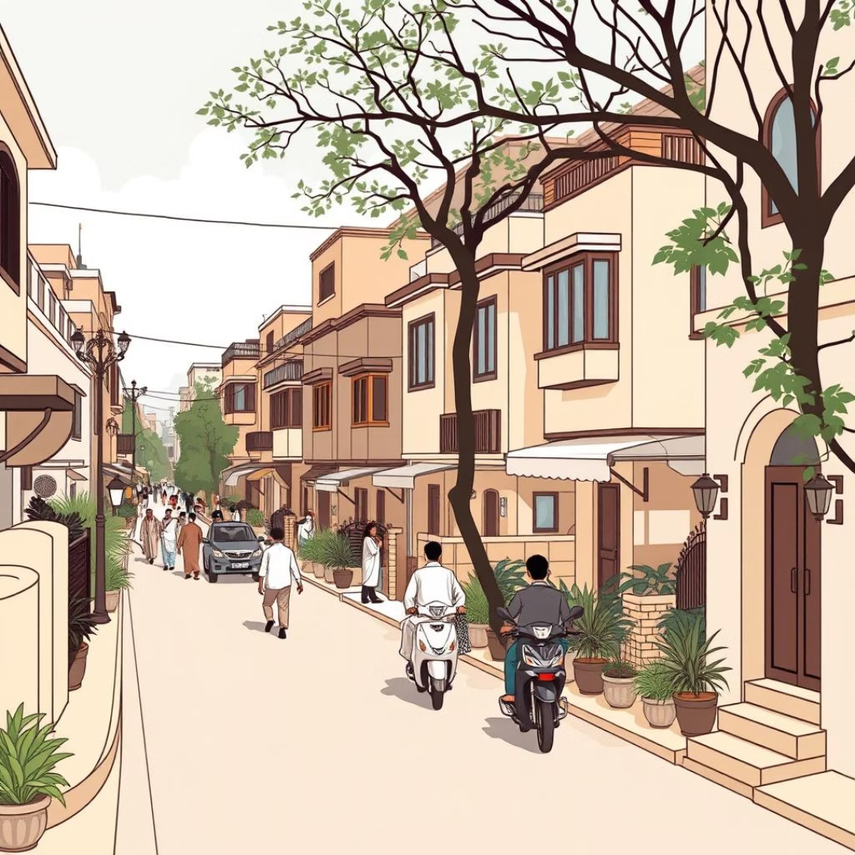
Dataset Summary: Pakistan's Real Estate Landscape
Total Properties: 2,036 unique listings were analyzed.
Property Types: Diverse range including Houses, Flats, and Penthouses.
Price Range: Properties valued from 7 Million to over 50 Million PKR.
Key Features: Area, number of bedrooms, bathrooms, city, and specific location details.

Slide 5
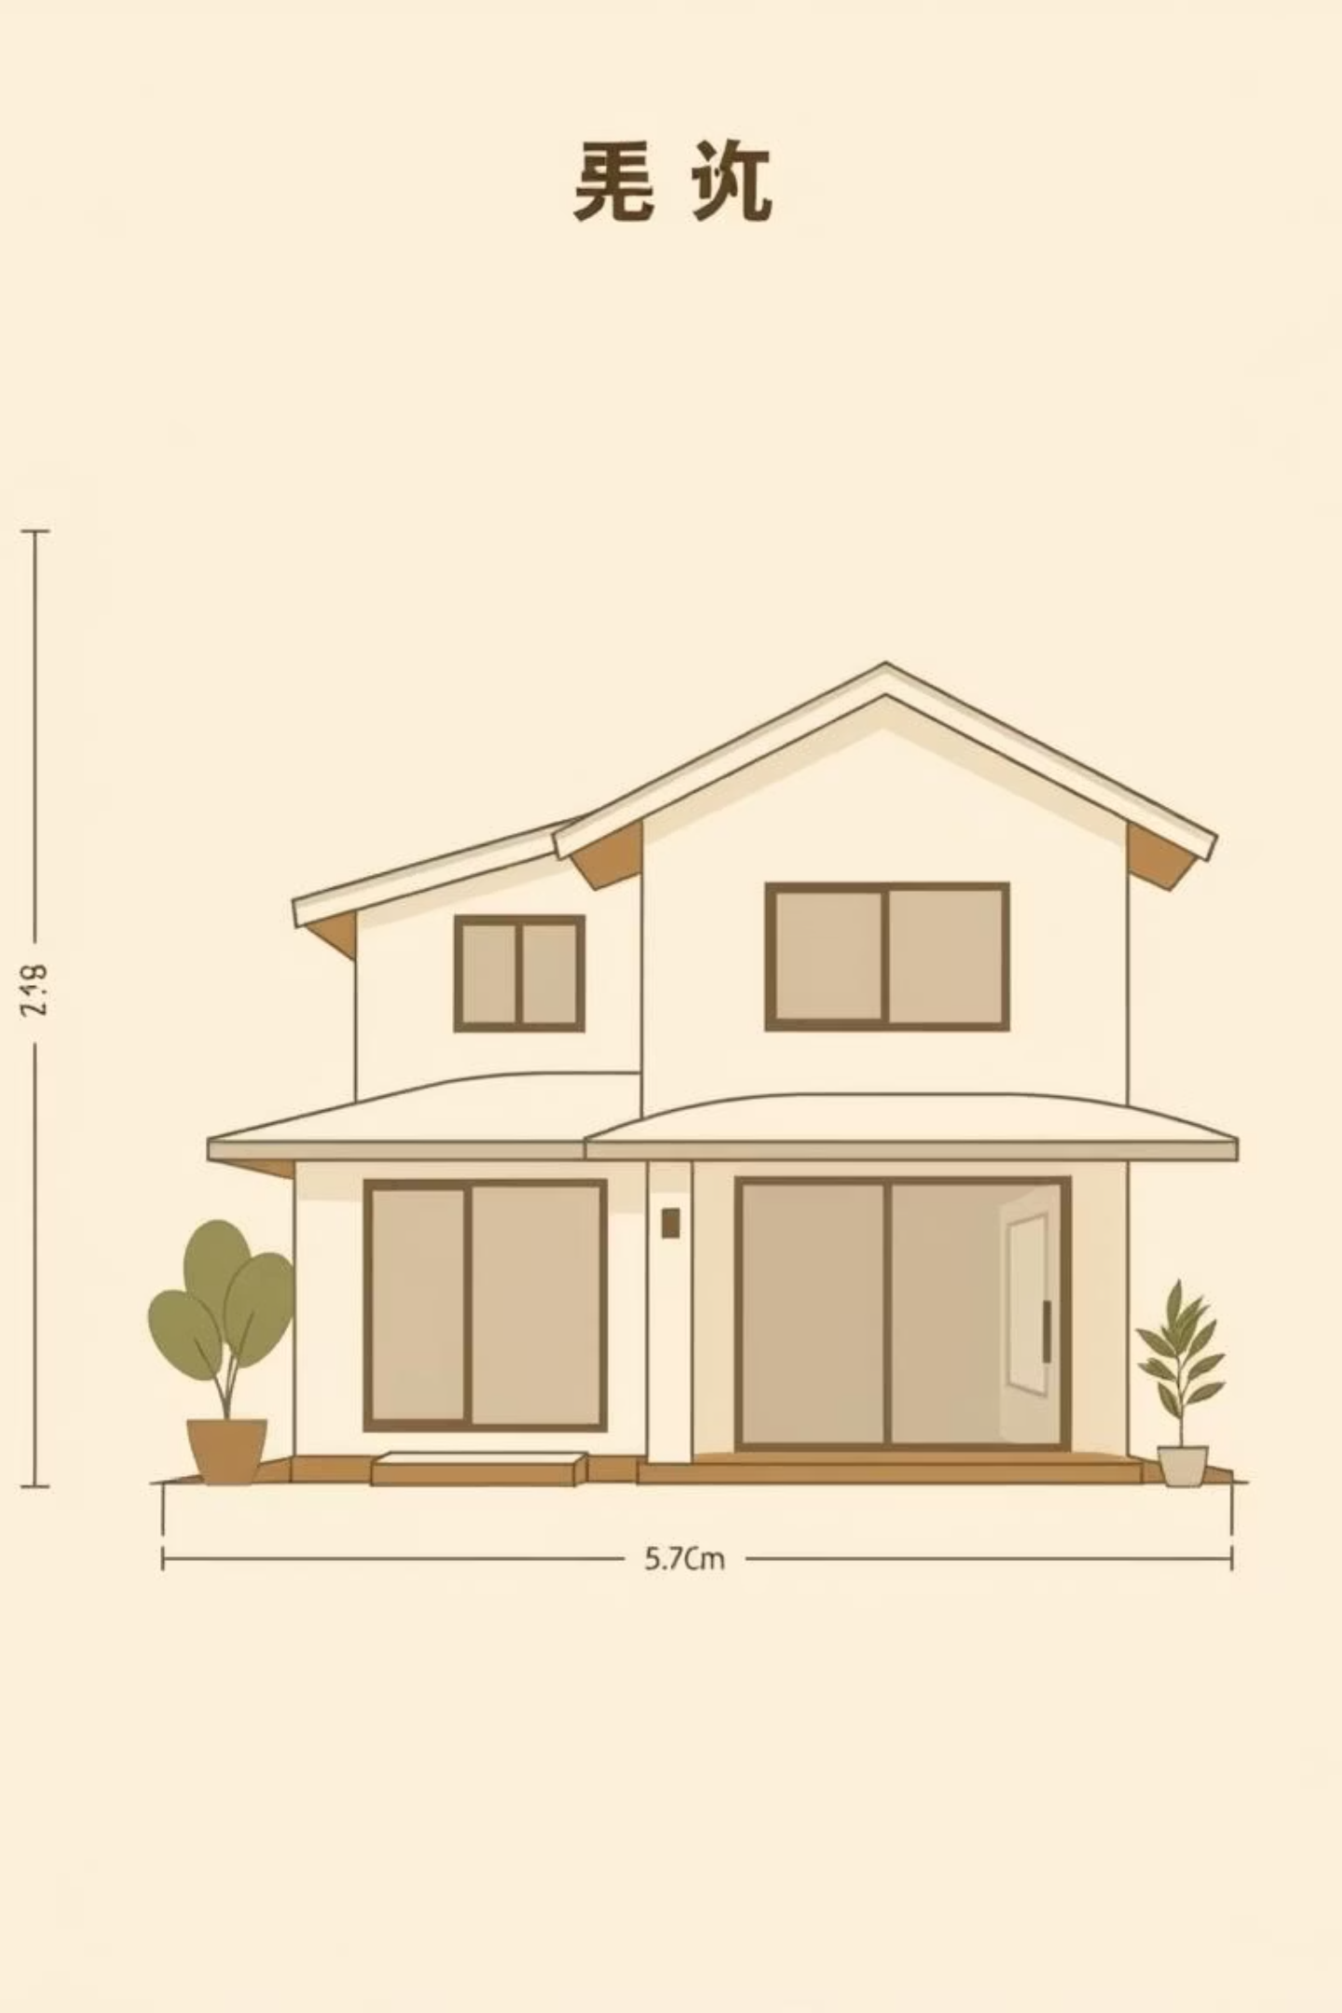




Important Features Influencing Price
Price
The ultimate target value we aimed to predict and understand in our analysis.
Area
Measured in traditional Pakistani units like Marla/Kanal, then converted to square feet for consistency.
City
A significant determinant of property value, with distinct pricing trends across different urban centers.
Rooms
The number of bedrooms and bathrooms directly correlates with property size and, consequently, its market price.

Slide 6
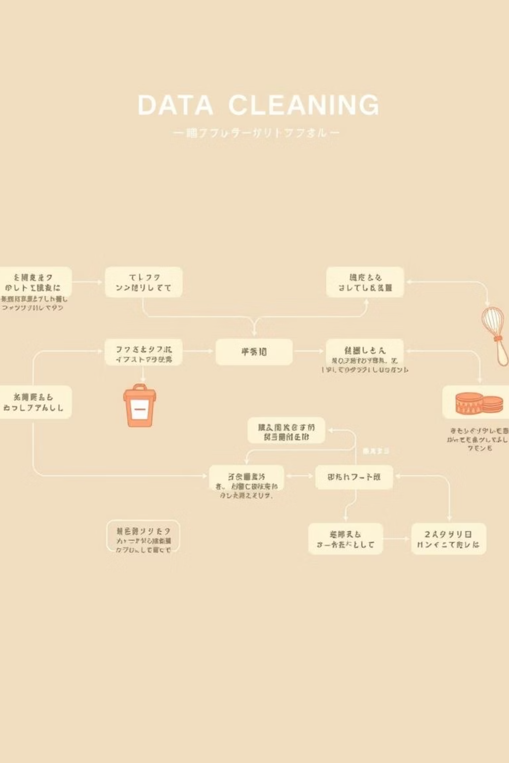
How We Cleaned the Data
01
Unit Conversion
Standardized area measurements by converting Marla and Kanal units into universal square feet for accurate comparison.
02
Outlier Detection & Removal
Identified and addressed anomalous or incorrect data entries to prevent skewing of analytical results.
03
Data Transformation
Prepared and structured the refined dataset for optimal performance and compatibility with Machine Learning models.

Slide 7
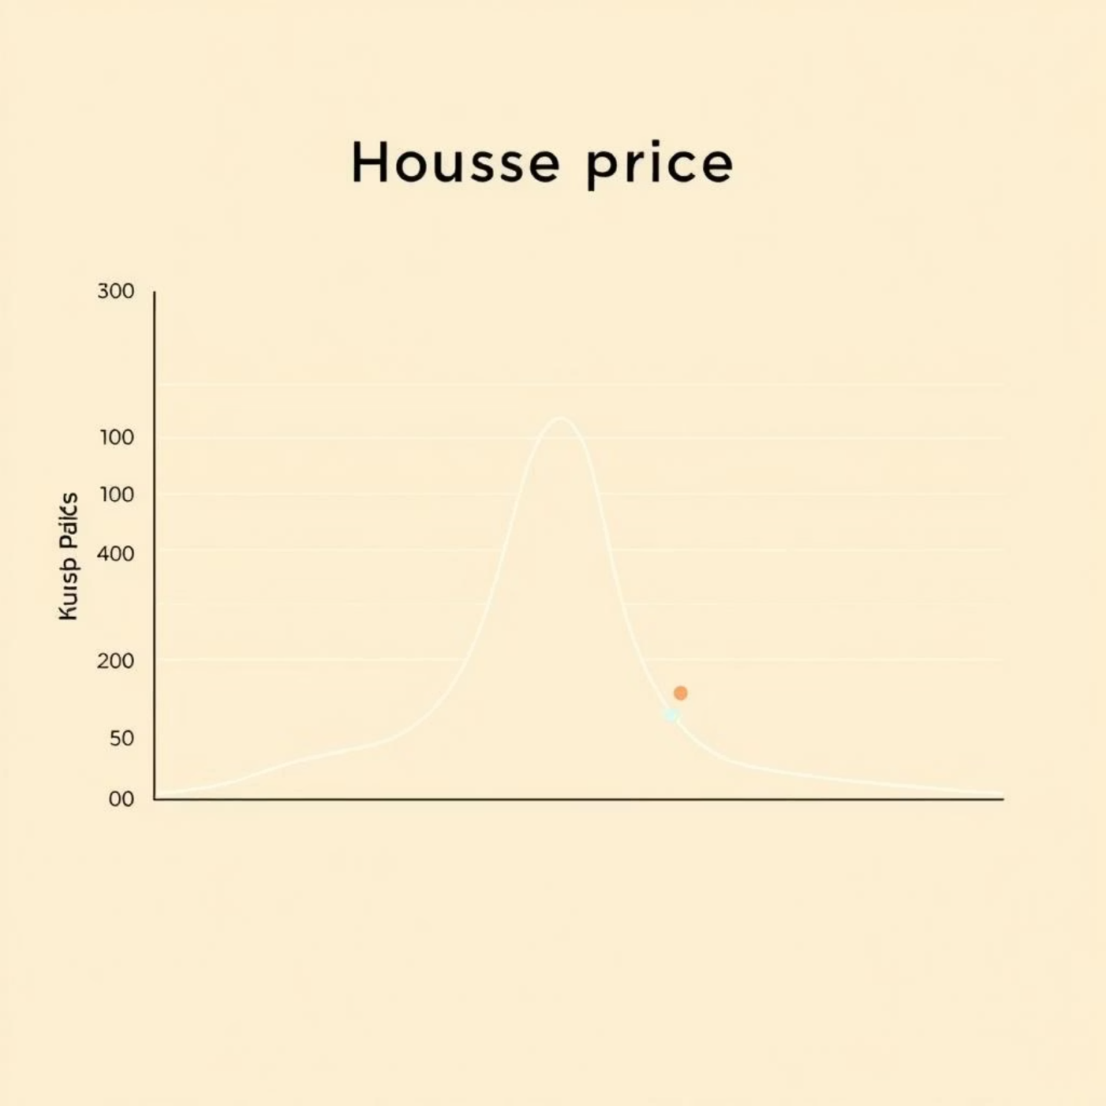
Exploratory Data Analysis (EDA) Insights
Islamabad's Premium Market
Properties in Islamabad consistently commanded higher prices compared to Lahore and Karachi.
Size-Price Correlation
A clear positive correlation was observed: larger house areas directly translated to higher selling prices.
Room Count Patterns
Distinct pricing tiers emerged based on the number of bedrooms and bathrooms, revealing buyer preferences.
Price Distribution & Outliers
Analysis of price distribution highlighted some high-value outliers, indicating luxury segments or unique properties.

Slide 8


Machine Learning Models Used
Random Forest (Best Model)
Linear Regression
Achieved the highest accuracy and robustness in predicting house prices with an impressive R² score of 0.994.
A foundational model used for establishing baseline performance and understanding linear relationships within the data.
K-Nearest Neighbors (KNN) Regression
Explored for its non-parametric approach, suitable for identifying local patterns in price prediction.

Slide 9

Clustering: Understanding Market Segments
Utilizing the K-Means clustering algorithm with k=6, we successfully segmented the property market into distinct groups. This approach allowed us to categorize houses based on their unique combinations of price and size, offering a clearer picture of market dynamics.
K-Means Algorithm: Applied to identify natural groupings.
6 Clusters: Optimized for diverse market segmentation.
Grouping Logic: Properties grouped by similar price and size characteristics.
Market Insights: Clearly differentiated low, mid, and high-end market segments.

Slide 10
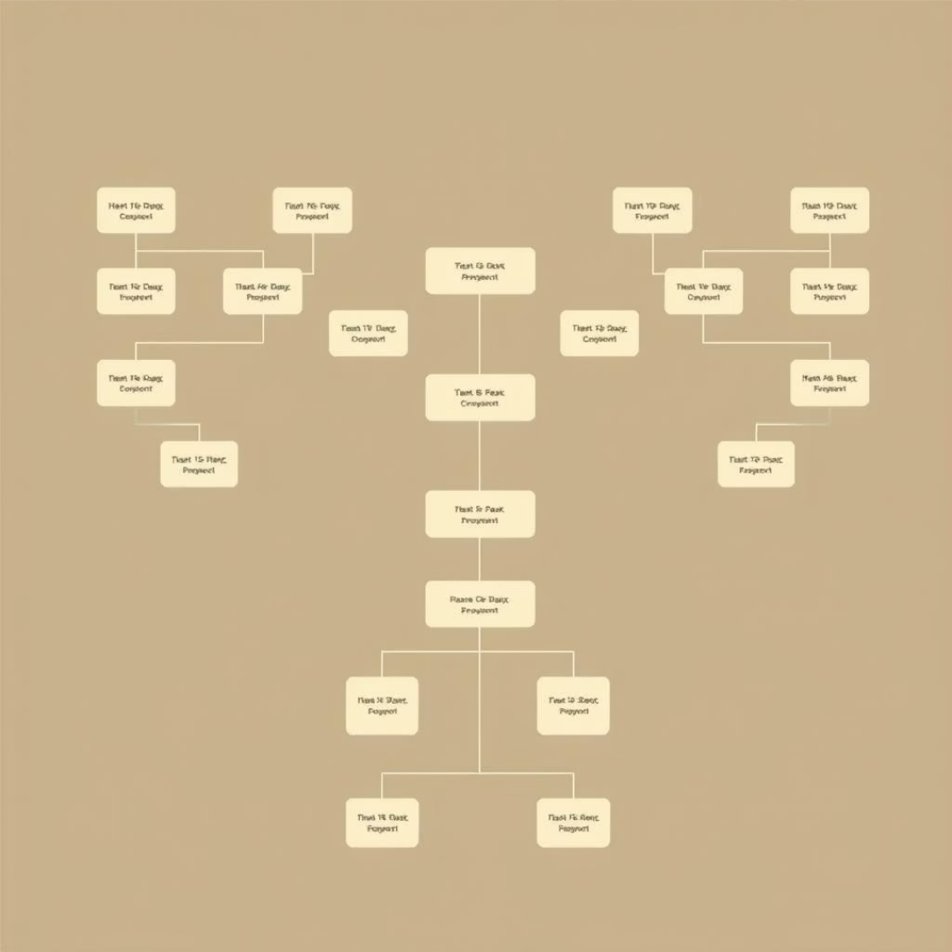
Sale vs. Rent Classification
Decision Tree Model
Employed a Decision Tree for its transparency and ease of interpretation.
Simplicity & Explainability
The model's straightforward nature makes it easy to understand the factors influencing classification.
Prediction Capability
Aids in accurately predicting whether a property listing is intended for sale or rent based on its features.

Slide 11

Key Findings from Analysis
Feature Correlation
Larger areas, more rooms, and specific city classifications directly
contribute to higher property valuations.
Islamabad's Premium
Our analysis consistently shows that properties in the capital city command the highest prices across Pakistan's market.
Seasonal Trends
Property listings and sales exhibit predictable seasonal fluctuations, impacting market
liquidity and timing.
Segmented Market
Clustering revealed distinct market segments based on property characteristics, offering tailored insights for stakeholders.

Slide 12

Conclusion
Use Random Forest to predict prices accurately.
Clustering shows different buyer groups.
Add neighborhood data to improve results.
Deploy the model on real estate platforms.

